Slide 1
Oral Presentation 2
Liao Wenjun (A0217795N)
25/01/24
Notes:
Good Afternoon Prof Young, here is my Final year project preliminary 2 presentation

Slide 2
Table of Content
Project Outline
Project Progression - Machine Learning - Feature Importance - Deep Learning
Code Examples
Future Plans
Notes:
So, here are the contents that I would be going through today. Firstly, a general outline of the project, next, what I have done for the past semester with some code examples as illustrations and future plans.

Slide 3


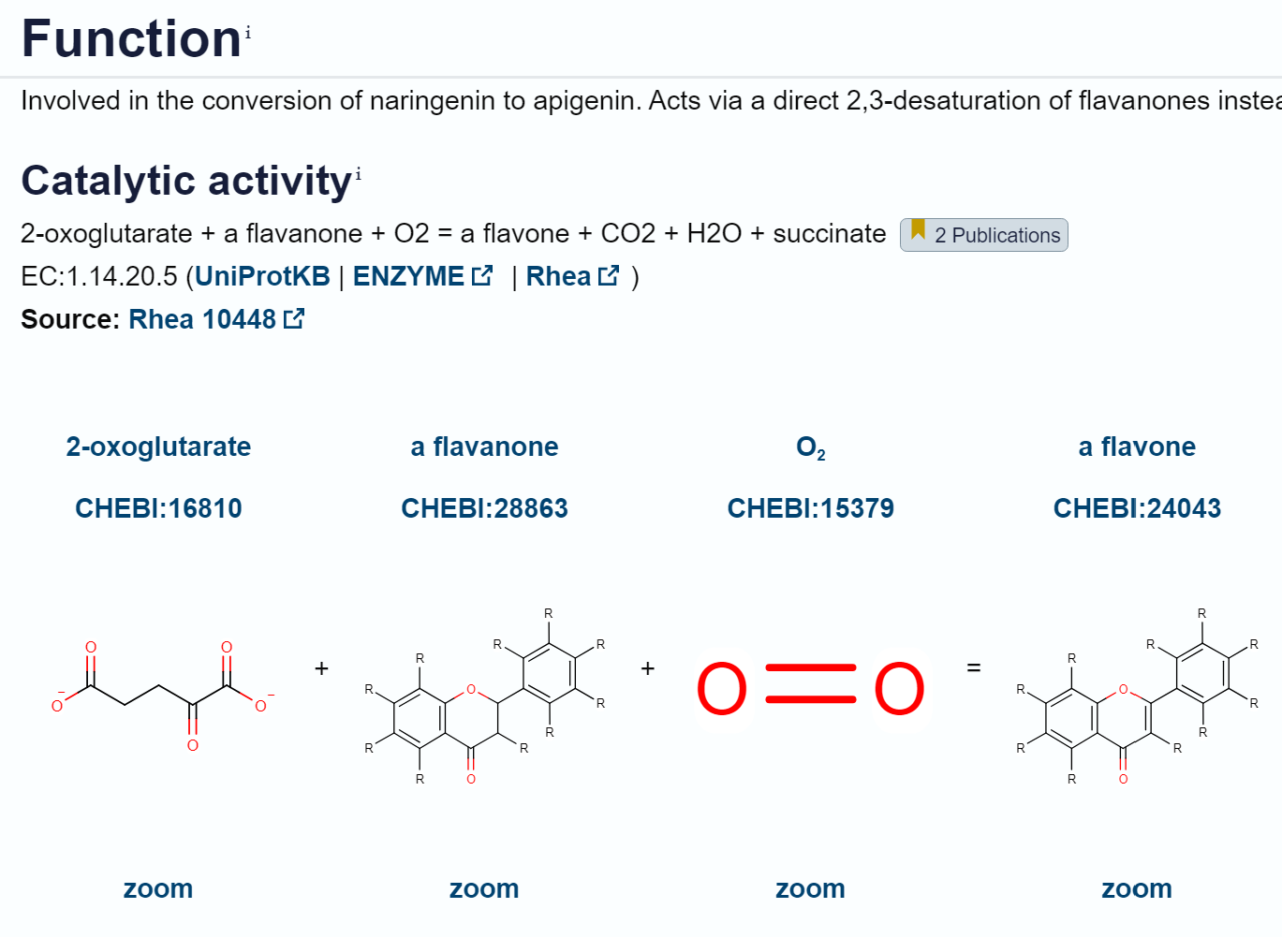

Project Outline
Title: 'Machine learning for Biodesign of engineered biological systems'
Concept: Experiments were conducted to record the fluorescence activity of randomly mutated Flavone Synthase enzymes and their corresponding DNA sequences.
Goal: Utilise Machine Learning to identify the most productive enzyme variants, ultimately determining the efficacy of specific mutations.
Notes:
The title of my project is (CLICK) “Machine Learning for Biodesign of engineered biological systems.”
(CLICK) We are studying an enzyme called Flavone Synthase and microfluidic experiments were conducted to record the Fluorescence activity of randomly mutated enzyme and their corresponding DNA sequences.
The main purpose of this enzyme is to catalyse the conversion of naringenin, which is mainly found in citrus fruits, to apigenin, which has many medical functions such as antiviral, antibacterial, antioxidant, and strong anti inflammatory activities and blood pressure reduction
(CLICK) The goal is to Utilise Machine Learning to train a model that can link the DNA sequences to their expression levels which can identify the most productive enzyme variant sequences and ultimately generating a DNA sequence that can yield the enzyme with highest output.

Slide 4
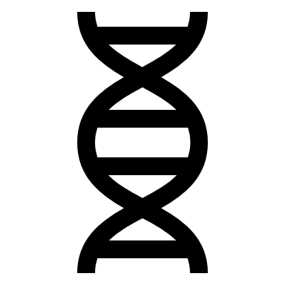
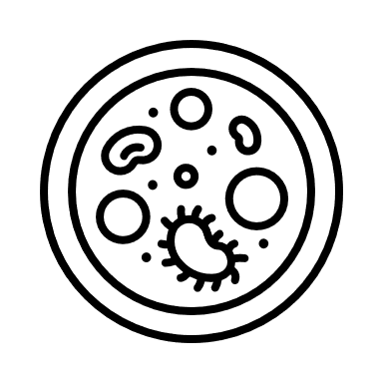


Literature Reviews
Central Dogma of Molecular Biology
Enzyme Engineering
Machine Learning
Notes:
To familiarise myself with the theoretical aspects at the start of the project, I did lit review on these topics.
In the sphere of Biodesign, understanding the DNA sequence, a blueprint that dictates the structure and function of proteins, is important. Mutations in this sequence can intricately alter the active sites of enzymes, where biochemical reactions occur. As DNA codes for amino acids, the building blocks of proteins, even a subtle change of one DNA base can code for a different amino acid and leads to significant variations in protein structure.
These structural nuances directly influence enzyme efficacy. This lead me to read up more about Enzyme Engineering, where other researchers tried various methods to improve the efficiency of enzymes.
All in all, it is crucial to decipher the complex relationship between DNA mutations, protein structures, and functional outcomes.
And in depth reading on Machine Learning was required.

Slide 5
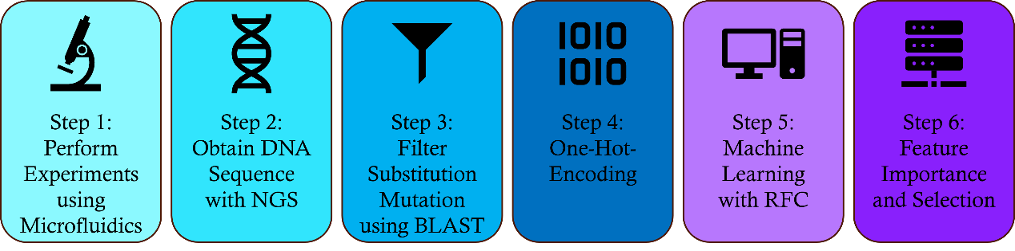
Project Progression
Experiment: - Microfluidics
Notes:
When I took on this project, microfluidics experiments on the enzyme was already done and masters student Sangeetha did an extensive work on machine learning portion as well.
Firstly, using microfluidics, millions of droplets of randomly mutated enzyme underwent screening for fluorescence activity, and they were classified into three performance categories: High, Medium, and Low.

Slide 6
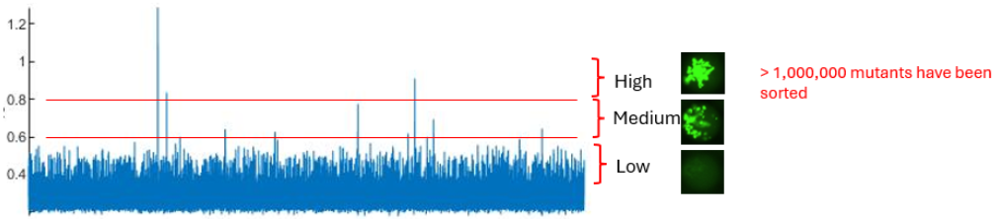
Project Progression
Experiment: - Microfluidics - Next Generation Sequencing
Notes:
The samples were subjected tovNext Generation Sequencing (NGS) to identify the DNA sequences and stored in our database. In this image, we can see a subset of the millions of data gathered and the red lines represent the thresholds for the respective classes.

Slide 7
Project Progression
Experiment: - Microfluidics - Next Generation Sequencing
Machine Learning: - 500 DNA bases (active site) - 1.3 million substitution mutations filtered using BLAST
No. of Possible Mutations: 4^500 → 302 digits
Notes:
Considering the diversity of mutations arising from random mutagenesis, such as insertion, deletion, and so on, we focused solely on substitution mutations in the active site of the enzyme, which consists of 500 bases. Through the application of the Basic Local Alignment Search Tool (BLAST) alignment, we compared the mutant sequences with the wild type sequence, extracting only those sequences displaying substitution mutations. This curated dataset formed the basis for our Machine Learning (ML) analysis. I would like to take this opportunity to emphasis that although 1.3million data sounds like a lot, it really isn’t when we compare to a possibility of 4 to the power of 500. Hence, the rationale of using machine learning is to learn the patterns of the DNA sequence using this subset data, and predict the efficiency of a new sequence in silico so that we do not need to perform an absurd number of real life experiments.

Slide 8
Project Progression
Machine Learning: - One Hot Encoding of DNA sequence - A,T,C,G → Binary (0,1) - Python: get_dummies function
Notes:
ML is a powerful statistical tool that primarily relies on numerical patterns and statistical properties within data to predict unseen patterns [5]. The DNA sequences we have obtained are represented by alphabetic characters, A, T, C, G, necessitating transformation into numerical data suitable for ML algorithms. To achieve this, we employed the One Hot Encoding (OHE) technique using the Python 'get_dummies' function. More will be explained ltr as I go through the code.

Slide 9
Project Progression
Random Forest Classification Model:
RFC is an ensemble learning method that combines the predictions of multiple decision trees to improve accuracy and robustness. It constructs a multitude of decision trees during training and outputs the mode of the classes (classification) or the average prediction (regression) of the individual trees.
Notes:
Sangeetha performed multiple experiments using many Classification models and RFC yielded the best results, which I will share later. I shall skip the definition of RFC due to time limitations
The model consists of 400,000 sequences from each class, High, Medium, and Low.

Slide 10
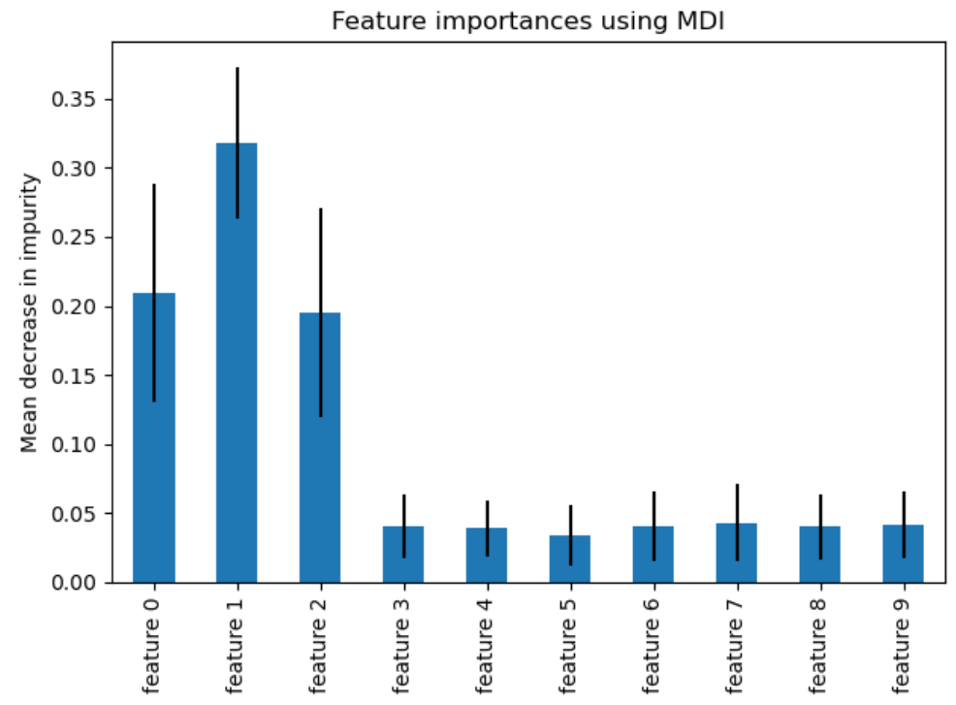
Project Progression (Interim 1)
Feature Importance
Feature Selection
Notes:
Here is the project progression on my part after learning about the project and what Sangeetha has done.
From the one hot encoding, a total of 2212 features were used in the ML.
I have with me a graph displaying feature importance not related to our work.
Each feature has a corresponding value assigned by the model and that is feature importance.
In datasets with an abundant of features, not all features contribute equally to the model’s performance.
Feature selection helps in reducing the dimensionality of the data and makes the model simpler, easier to interpret and less prone to overfitting. For example, we can select the features of higher importance, and ignore those with low importance.

Slide 11
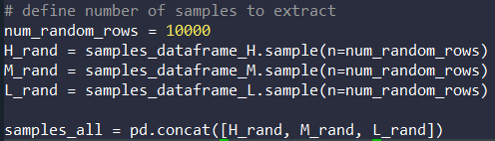
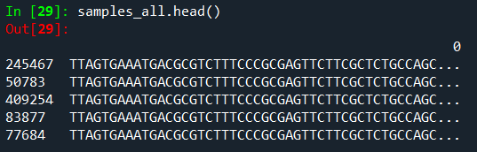
Code example (Sample extraction)
1. Extracted 30,000 samples
2. How samples_all looks like -left column due to random extraction
Notes:
To illustrate my work more clearly, I have inserted screenshots of important codes and functions
Firstly, we extracted 10,000 samples from each class randomly and compile them
(point using laser)
Here are rows of 500 bases each containing the mutated DNA sequence

Slide 12
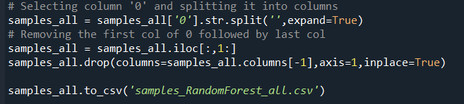
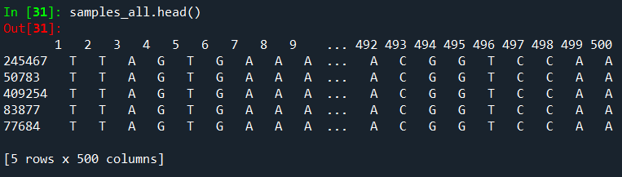
Code example (Pre-processing)
3. Separating each rows into 500 bases
4. Removing unnecessary columns
Notes:
Next, we have to perform some processing on the data by changing each row into 500 columns instead of just 1 column with 500 bases.

Slide 13
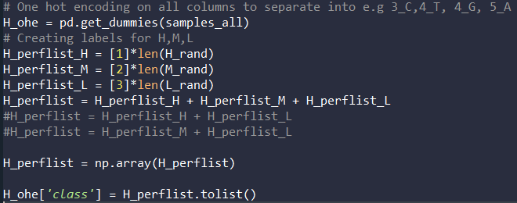
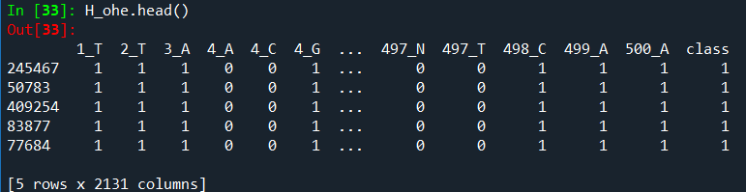
Code example (One-Hot-Encoding)
5. get_dummies does One Hot Encoding
6. Create a column: ‘class’ to distinguish H,M,L
Notes:
As mentioned earlier, we have to convert the DNA sequence into the binary OHE sequence and add a column of class at the end of it.
Here is an example, where there are mutations on the 4th base, there are 3 columns starting with 4, followed by the base, A,T,C or G
In this row (point using LASER) the DNA base at position 4 is G, hence, there will be a 1 on 4_G and 0 on the other 4_0. In certain rows not seen here, 4_G will be 0 and 4_A will be 1 for example.

Slide 14
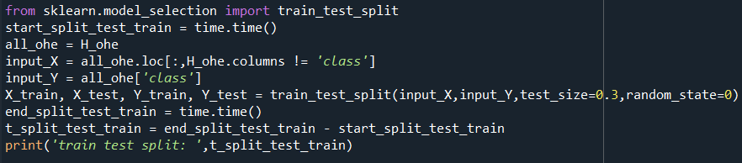
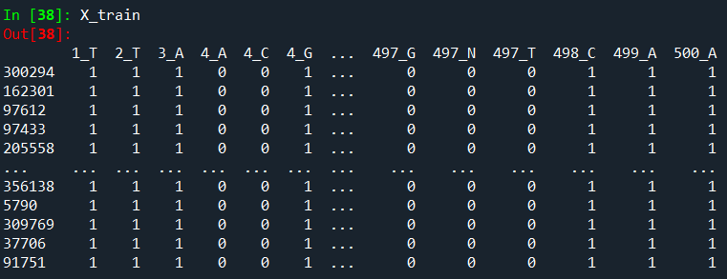
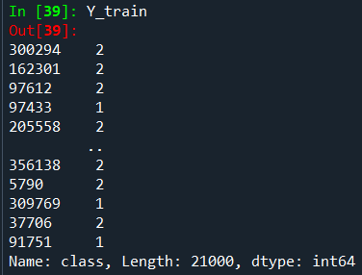
Code example (Model Building)
7. X input: OHE Bases
8. Y input: Class
9. Split train and test set into 70/30
Notes:
Now that we have the inputs, X and Y as the OHE bases and the Class respectively, we can build the model by splitting into train and test sets.

Slide 15

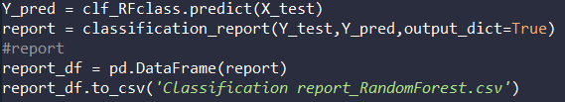
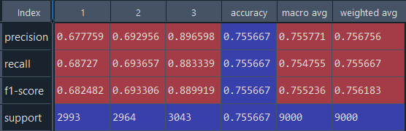
Code example (Results)
10. Input model and fit in inputs
11. Prediction results and Classification report generation
Precision: Measures how often a machine learning model correctly predicts the positive class.
Recall: True Positive Rate
F1-score: Combination of Precision and Recall to measure a Model’s accuracy
Support: The number of actual occurrences of the class in the specified dataset
Notes:
After training the model, it can be used on the test set and to obtain the results. And the report we generated consist of precision, recall, and F1-score.
NEXT SLIDE
In machine learning, precision, recall, and F1 score are important evaluation metrics used to assess the performance of classification models. Precision is the ratio of correctly predicted positive observations to the total predicted positives. Recall, or true positive rate, is the ratio of correctly predicted positive observations to all actual positives. The F1 score ranges from 0 to 1, where 1 indicates a perfect balance between precision and recall. It penalizes models that have imbalances in precision and recall, offering a single metric to evaluate a model's performance, hence, we will be comparing the F1-score.
The micro average precision is the sum of all true positives divided by the sum of all true positives and false positives and it is represented by accuracy in the table
Macro average is the mean of these 3 values in the column and Weighted avg includes the number in the support.

Slide 16
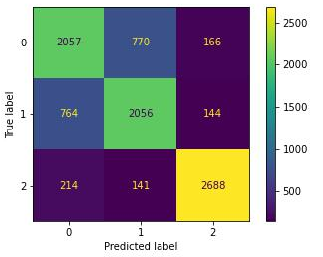
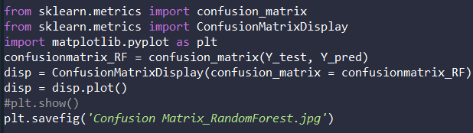
Code example (Results)
12. Confusion matrix
Notes:
A confusion matrix was obtained as well so it can be seen clearly how many samples were true to their predictions.

Slide 17

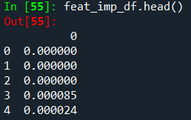
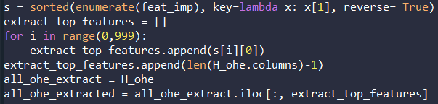
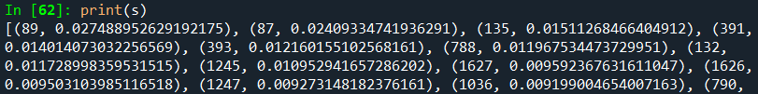
Code example (Feature Importance and Selection)
Notes:
Moving on, feature importance and selection was performed.
First, we need to use a feature importance function to extract out the value of importance for each feature, followed by sorting them from high to low. After which, we can extract the top n number of features, in this case 1000, and train a model using just 1000 features.
The sorted feature importance looks like this, where the position is shown with the value.

Slide 18
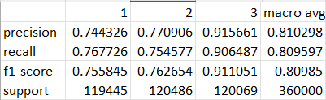
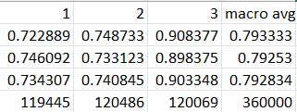
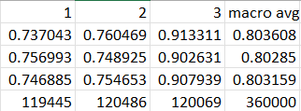
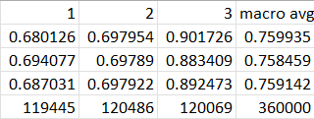
Results (Full dataset)
Without Feature Selection
With Feature Selection of 1000
With Feature Selection of 1500
With Feature Selection of 500
Notes:
Here are the results from the full dataset of 1.2 million mutants that I ran on the school’s high performing computer server. I performed feature selections of 1500, 1000, and 500 for comparison with the dataset without the implementation of feature selection.
Lets focus on the F1-score. It can be seen that without feature selection, the result is 0.809 (click) and slowly decreases to 0.803(click) in 1500 features selection followed by 0.792 (click) and 0.759(click) in 1000 and 500 respectively.
The small decrease in the score is expected as some features were lost, but the gain in computational time and effort outweighs this small loss of 3 decimal places. With only a drop in 0.017, it is safe to use the model trained from 1000 features selected. This vastly improves the computational time needed to sort through the 4^500 possible permutations in silico.
However, with a low prediction rate at roughly 74% for High and Medium Classes, we decided to explore DL to improve the results.

Slide 19

Project Progression
Step 6:
Deep Learning
Deep Learning:
-Different Architectures: Experiment with different neural network architectures.
-Multi-layer Perception(MLP), Recurrent Neural Networks (RNNs) and 1D Convolutional Neural Networks (CNNs) are all suitable for sequential data like DNA sequences.
Notes:
To start on deep learning, I read many literatures which used deep learning for amino acid sequence or protein design studies and some also did DNA sequences. Hence, we were inspired to go in this direction as well. There are many types of DL models and certain models are more suitable for sequential data that fits our case of DNA sequence.

Slide 20

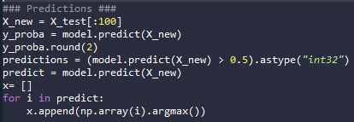
Deep Learning Code
Steps:
Same Steps as ML
Build model
Compile Model
Fit Model
Predictions
Notes:
To build a deep learning pipeline, we can follow the ML steps including OHE up to the train and test split. After Which,
(CLICK) We can build a sequential model and define the number of layers in each neuron
(CLICK) Next, we have to compile the model by stating various parameters that can affect the way the model is trained, for example the optimizer.
(CLICK) Next, we need to fit the model with our own data and define the number of epochs, which means one complete pass of the training dataset through the algorithm.
(CLICK) Lastly, we can test the model by predicting the test set.

Slide 21
Results (ML & DL)
Test Runs | Optimizer | Epochs | Train/Test | High (%) | Medium (%) | Low (%) | Overall
1 | Adam(2 layers) | 30 | 70/30 | 66.55 | 82.65 | 89.25 | 79.48
2 | Adam(2 layers) | 50 | 70/30 | 74.89 | 77.04 | 87.53 | 79.82
3 | Adam(2 layers) | 70 | 70/30 | 80.00 | 69.72 | 87.32 | 79.01
4 | Sgd(2 layers) | 30 | 70/30 | 78.39 | 76.10 | 90.31 | 81.60
5 | Sgd(2 layers) | 30 | 90/10 | 84.90 | 68.91 | 88.77 | 80.86
6 | Adam (3 layers) | 30 | 70/30 | 72.70 | 77.66 | 90.03 | 80.13
7 | Adam (4 layers) | 30 | 70/30 | 74.53 | 76.52 | 89.86 | 80.30
8 | Adam (5 layers) | 30 | 70/30 | 76.87 | 71.78 | 90.60 | 79.75
9 | Adam (6 layers) | 30 | 70/30 | 80.70 | 70.90 | 88.32 | 79.97
10 | Adam (7 layers) | 30 | 70/30 | 73.63 | 75.56 | 90.07 | 79.75
11 | Adam (8 layers) | 30 | 70/30 | 81.77 | 68.71 | 90.41 | 80.30
12 | Adam (9 layers) | 30 | 70/30 | 70.25 | 80.83 | 89.46 | 80.18
x | RFC | - | 70/30 | 74.42 | 77.11 | 91.56 | 81.03
x | RFC (Feat Impt 1000) | - | 70/30 | 73.43 | 74.08 | 90.33 | 79.28
x | RFC (Sangeetha) | - | 70/30 | 72.3 | 76.3 | 91.8 | 80.13
Notes:
After trying various parameters for the deep learning model, here are the results obtained. To break it down, we can see the overall results stays around 80 percent regardless of ML or DL or any variation. However, we can observe 2 types of variations. There could be times when the model can predict high or medium at more than 80 percent but at the expense of a lower accuracy in medium or high respectively like so. NEXT SLIDE

Slide 22
Results (ML & DL)
Test Runs | Optimizer | Epochs | Train/Test | High (%) | Medium (%) | Low (%) | Overall
1 | Adam(2 layers) | 30 | 70/30 | 66.55 | 82.65 | 89.25 | 79.48
2 | Adam(2 layers) | 50 | 70/30 | 74.89 | 77.04 | 87.53 | 79.82
3 | Adam(2 layers) | 70 | 70/30 | 80.00 | 69.72 | 87.32 | 79.01
4 | Sgd(2 layers) | 30 | 70/30 | 78.39 | 76.10 | 90.31 | 81.60
5 | Sgd(2 layers) | 30 | 90/10 | 84.90 | 68.91 | 88.77 | 80.86
6 | Adam (3 layers) | 30 | 70/30 | 72.70 | 77.66 | 90.03 | 80.13
7 | Adam (4 layers) | 30 | 70/30 | 74.53 | 76.52 | 89.86 | 80.30
8 | Adam (5 layers) | 30 | 70/30 | 76.87 | 71.78 | 90.60 | 79.75
9 | Adam (6 layers) | 30 | 70/30 | 80.70 | 70.90 | 88.32 | 79.97
10 | Adam (7 layers) | 30 | 70/30 | 73.63 | 75.56 | 90.07 | 79.75
11 | Adam (8 layers) | 30 | 70/30 | 81.77 | 68.71 | 90.41 | 80.30
12 | Adam (9 layers) | 30 | 70/30 | 70.25 | 80.83 | 89.46 | 80.18
x | RFC | - | 70/30 | 74.42 | 77.11 | 91.56 | 81.03
x | RFC (Feat Impt 1000) | - | 70/30 | 73.43 | 74.08 | 90.33 | 79.28
x | RFC (Sangeetha) | - | 70/30 | 72.3 | 76.3 | 91.8 | 80.13
Notes:
The other type of result we can see is that both High and medium can get roughly 77%, which is better than ML.

Slide 23
Future Plan
Deep Learning experiments with sgd at higher layesr
More microfluidics experiment
Train model with only High and Low efficiencies
Notes:
There are possible ways to improve the deep learning results through methods like regularization, boosting and more and that would help increase the results by a few percentages. Experiments are still ongoing with sgd with more layers and also I plan on trying recurrent and convolutional neural network. I discussed with Prof Poh and came to a conclusion that we need more data. Hence, we would perform more microfluidics experiment in the upcoming weeks and also I thought of just training the model with only High and Low efficiency enzymes and have started testing the combinations of just high and low data in a model, High and medium combined to be classified together as High, and also Medium and Low combined.
I have also studied up on large language modelling which is widely known to be used in ChatGPT and many protein modelling and designing. However, after through research, we have concluded that this pathway may not be suitable for our classification task of just high, medium and low.

Slide 24
Future Plan
Month | Aug |  | Sep |  |  |  | Oct |  |  |  | Nov |  | Nov | Nov |  |  |  |  | Dec | Dec |  |  |  |  | Jan | Jan |  |  |  |  |  | FEB |  |  |  | MAR |  |  |  | APR |  |  |  |  | MAY
Week | 2 | 3 | 4 | 5 | 6 | RW | 7 | 8 | 9 | 10 | 11 |  | 11 | 12 | 13 | 13 | 14 | 15 | 16 | 16 | 17 | V1 | V2 | V3 | V4 | V5 | 1 | 2 |  | 3 |  | 4 | 5 | 6 | RW | 7 | 8 | 9 | 10 | 11 | 12 |  | 13 |  | 17 |  | 19
Familiarize
Feature Selection
Hyper- parameter tuning
Other Classification Model
Cross fold validation
Deep learning
Predictive Capability
Progress Report 1
Preliminary Oral 1
Progress Report 2
Preliminary Oral 2
FYP work end
Thesis Submission
Final Submission
Notes:
With a F-score of 0.79, the model is not good enough. One possible reason could be that the amount of training data is not enough. With 500 bases and the possible mutation of 4 nucleotide each base, a total of 500⁴ mutants could be obtained. However, we only have 1.2 million of experimental data. With more data, we can successfully obtain higher accuracies since the model can be identify more prominent features.
Deep learning (DL) can be explored for this project. Deep learning models, particularly recurrent neural networks (RNNs) or convolutional neural networks (CNNs) specialized for sequential data, can learn intricate patterns and representations from DNA sequences. A similar approach to ML using OHE can be used since DL requires numerical input as well.

Slide 25
Thank You
Questions?

